Slide 1
Apache Tomcat Server - Quick Start Guide
Installation and Configuration.

Slide 2
Why Apache Tomcat ?
Apache HTTP server is a popular industrial-strength production server, produced by Apache Software Foundation (ASF).
It is very simple to setup.
It is a great tool to start with to learn HTTP programming basics.
It is implements web container that would run servlets and java server pages.

Slide 3
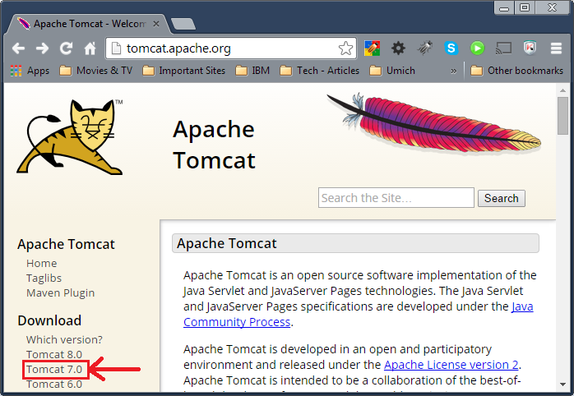
How to get Apache Tomcat ?
Go to the following URL http://tomcat.apache.org/ (or search for Apache Tomcat in google and find the site).
Select the appropriate version to download from the site.

Slide 4
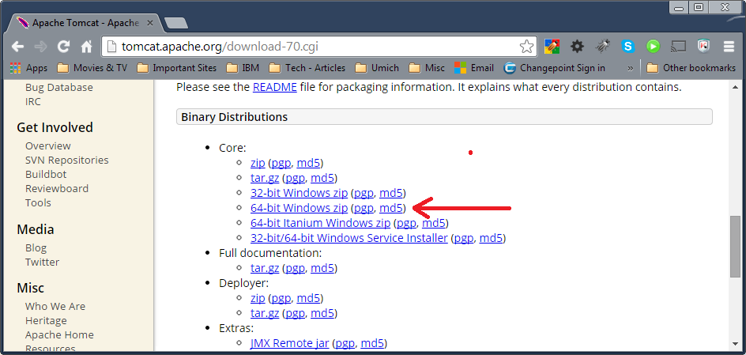
Which Version ?
Based on your system processor architecture and JRE installed download the version.
I will be using Tomcat 7.0.55, with JRE 1.7 on a 64 bit Windows 7 Operating System.

Slide 5
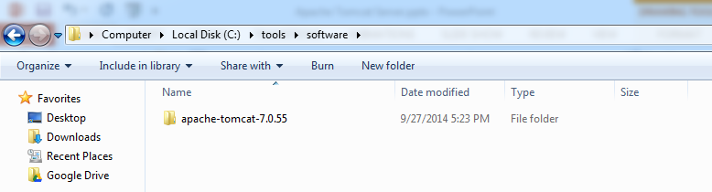
Steps to Install and Configure
After downloading the zip file, extract it to c:\tools\software folder.
After you copy the file it should look as follows.

Slide 6
Environment Variables
Please ensure that you have already installed JDK, and JRE version 1.7 or higher.
Also make sure that JAVA_HOME, and JRE_HOME variables have been set.
Set the following environment variables
CATALINA_HOME = C:\tools\software\apache-tomcat-7.0.55
CLASSPATH = %CLASSPATH%;% CATALINA_HOME%\lib\servlet-api.jar; % CATALINA_HOME%\lib\jsp-api.jar;
PATH=%PATH%; % CATALINA_HOME%\bin\;

Slide 7
Tomcat Users Configuration
With in C:\tools\software\apache-tomcat-7.0.55\conf folder edit the following file tomcat-users.xml
Uncomment the roles and users
<!--
<role rolename="tomcat"/>
<role rolename="role1"/>
<user username="tomcat" password="tomcat" roles="tomcat"/>
<user username="both" password="tomcat" roles="tomcat,role1"/>
<user username="role1" password="tomcat" roles="role1"/>
-->
Also Add the following role and user name
<role rolename="manager-gui"/>
<user username="admin" password="admin" roles="manager-gui"/>

Slide 8
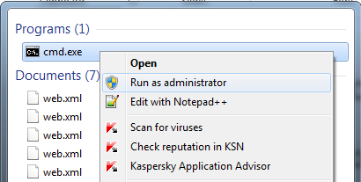
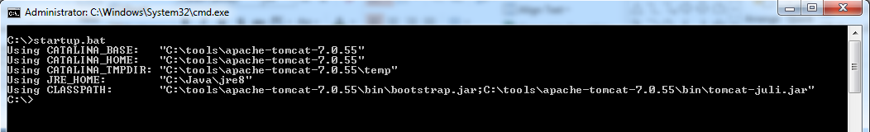
Tomcat : Start and Stop
Open command prompt as administrator
Type the following command

Slide 9
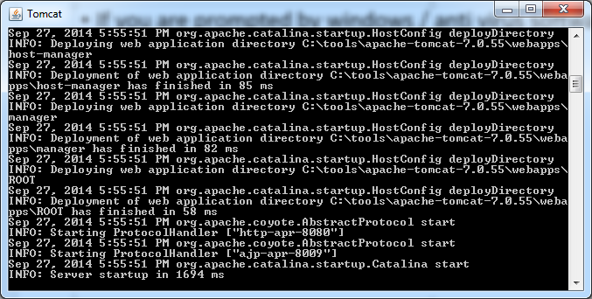
Tomcat : Start and Stop
If you are prompted by windows / anti virus software about network access, select allow access.
You will see a popup window as follows

Slide 10
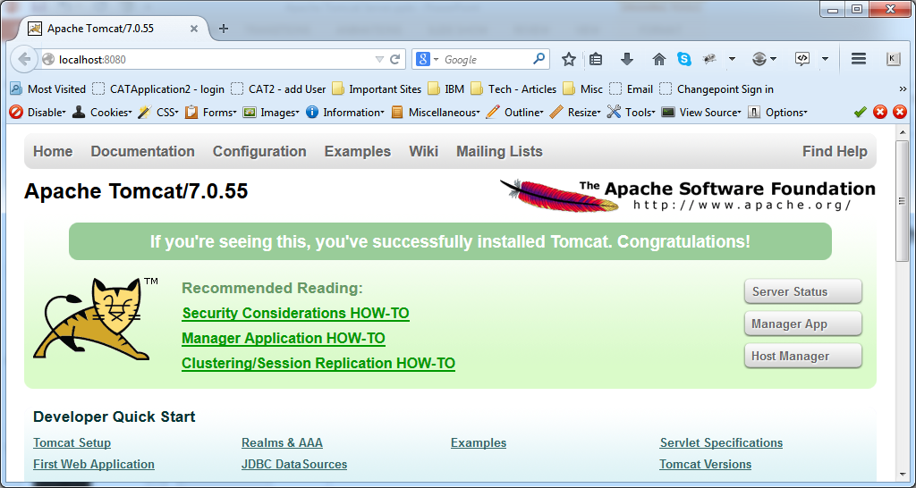
Tomcat : Start and Stop
Once the server is started, open the browser and type the following URL http://localhost:8080 (you should see the following screen).

Slide 11
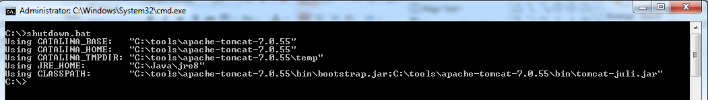
Tomcat : Start and Stop
To stop the tomcat server type the following command in the command prompt window that you have already opened as administrator.

